Slide 1


Rafael Muniz
January 1st 2024

Slide 2

Outline
Executive Summary
Introduction
Methodology
Results
Conclusion
Appendix

Slide 3
Executive Summary
Summary of methodologies
Data collection with REST API and Web Scraping
Data Wrangling
Exploratory Data Analysis with SQL and Data Visualization
Interactive visual analytics using Folium
Machine Learning models
Summary of all results
This presentation shows the insights from the Exploratory Data Analysis, showing that orbits ES-L1, GEO, HEO, and SSO have the best success rates and that the success rate by year in an upward trend. From the interactive visual analytics, it shows that KSC LC-39A launch site has the most successful number of launches, and Booster version FT has the most successful launch outcomes. At the Machine Learning section, it shows that after fine tuning the models, they all have the same accuracy when predicting the desired outcome, 83.3%.

Slide 4
Introduction
Project background and context
Commercial space age emergence
Different players: Virgin Galactic, Blue Origin, Space X – working towards affordable space travel
Creation of Space Y company
Problems you want to find answers
Predicting if SpaceX will reuse the 1st stage of the Falcon 9 rocket, so Space Y can use that information to know the real cost of the rocket launch.

Slide 5

Section 1

Slide 6
Methodology
Executive Summary
Data collection methodology:
Data was collected using SpaceX API and Web Scraping techniques.
Perform data wrangling
Identification of missing values, numerical calculations, and one-hot encoding.
Perform exploratory data analysis (EDA) using visualization and SQL
Perform interactive visual analytics using Folium and Plotly Dash
Perform predictive analysis using classification models
How to build, tune, evaluate classification models

Slide 7
Data Collection
Data collected from a public data source with two methods:
SpaceX REST API
Link: https://api.spacexdata.com/v4/launches/past - the data in this API gives information about the rocket, payload, launchpad, landing specifications, and landing outcomes.
Decode the API response in JSON format
Transform it into a Pandas dataframe
Web Scraping from Wikipedia
Link: https://en.wikipedia.org/wiki/List_of_Falcon_9_and_Falcon_Heavy_launches
Extracting all the information of the table in Wikipedia using BeautifulSoup
Transform it into a Pandas dataframe

Slide 8
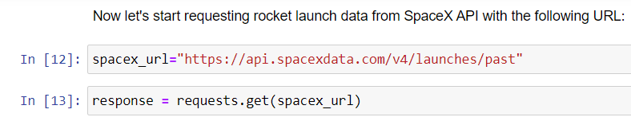
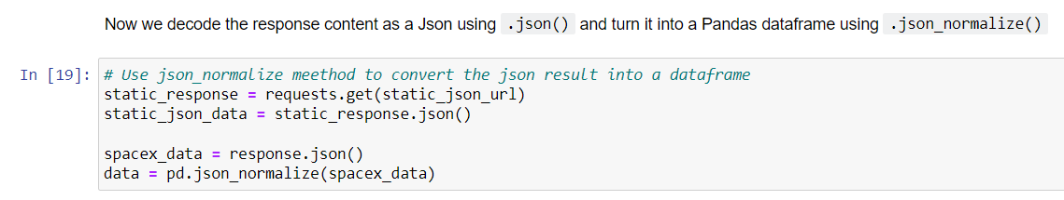
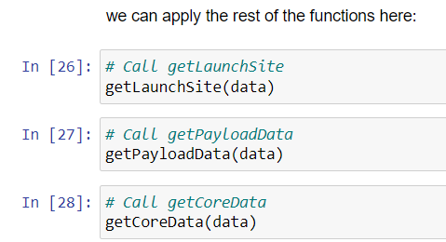
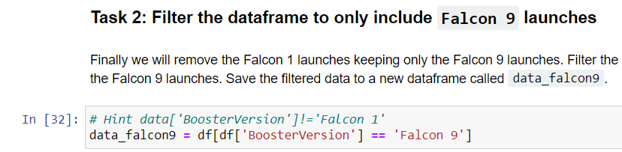
Data Collection – SpaceX API
SpaceX REST API calls:
GitHub URL of the SpaceX API calls notebook: https://github.com/rafael-muniz/dsproject01/blob/c6480e4e716b5f580bc31aa9a977bbc4cdf9f8ce/w1.1%20-%20jupyter-labs-spacex-data-collection-api.ipynb

Slide 9
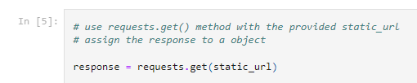
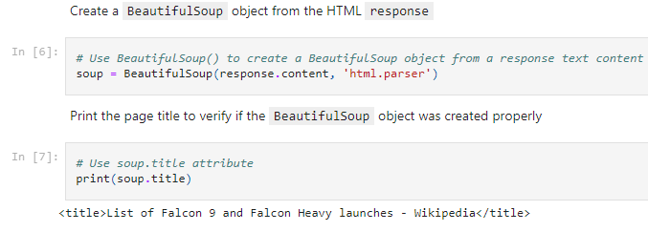
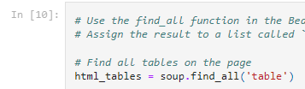
Data Collection - Scraping
1) Get the Wikipedia link
Web scraping from Wikipedia process:
GitHub URL of the web scraping notebook: https://github.com/rafael-muniz/dsproject01/blob/c6480e4e716b5f580bc31aa9a977bbc4cdf9f8ce/w1.2%20-%20jupyter-labs-webscraping.ipynb
2) Request the SpaceX Launch Wiki page
3) Using BeautifulSoup get and parse the data

Slide 10
Data Wrangling
Steps of Data Wrangling process:
Identify the missing values
Calculate the number of launches on each site
Calculate the number and occurrence of each orbit
Calculate the number and occurence of mission outcome of the orbits
Create a landing outcome label from Outcome column
GitHub URL of the notebook: https://github.com/rafael-muniz/dsproject01/blob/c6480e4e716b5f580bc31aa9a977bbc4cdf9f8ce/w1.3%20-%20labs-jupyter-spacex-Data%20wrangling.ipynb

Slide 11
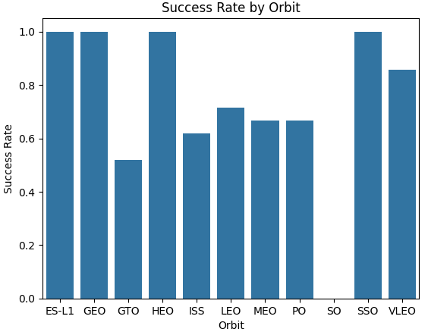
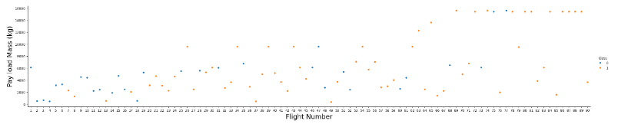
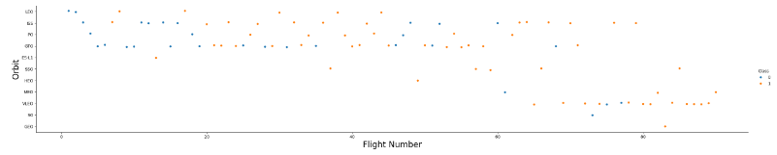
EDA with Data Visualization
Several charts were plotted: Flight number vs. PayloadMass, Flight number vs. Launch Site, Payload Mass vs. Launch Site, Orbit vs. Success Rate, Flight Number vs. Orbit, Payload Mass vs. Orbit, Year vs. Success Rate. A sample of them are shown below:
GitHub URL of the notebook: https://github.com/rafael-muniz/dsproject01/blob/c6480e4e716b5f580bc31aa9a977bbc4cdf9f8ce/w2.2%20-%20jupyter-labs-eda-dataviz.ipynb.jupyterlite.ipynb

Slide 12
EDA with SQL
SQL queries performed:
Displaying the names of the unique launch sites in the space mission
Displaying 5 records where launch sites begin with the string 'CCA’
Display the total payload mass carried by boosters launched by NASA (CRS)
Display average payload mass carried by booster version F9 v1.1
List the date when the first succesful landing outcome in ground pad was acheived.
List the names of the boosters which have success in drone ship and have payload mass greater than 4000 but less than 6000
List the total number of successful and failure mission outcomes
List the names of the booster_versions which have carried the maximum payload mass
List the records which will display the month names, failure landing_outcomes in drone ship ,booster versions, launch_site for the months in year 2015.
Rank the count of landing outcomes (such as Failure (drone ship) or Success (ground pad)) between the date 2010-06-04 and 2017-03-20, in descending order.
GitHub URL of the notebook: https://github.com/rafael-muniz/dsproject01/blob/c6480e4e716b5f580bc31aa9a977bbc4cdf9f8ce/w2.1%20-%20jupyter-labs-eda-sql-coursera_sqllite.ipynb

Slide 13
Build an Interactive Map with Folium
The following was marked in the Folium map:
All launch sites – to see where all he launch sites were in the US territory.
The success/failed launched for each site – assigning with green (success) and red (failure) the launches in each launch site, to give a better understanding of how the launches performed in each site.
Distances between one of the launch sites to its proximities (railway, highway, coastline, city), with the use of a line – to know the distance to some key points of interest, avoiding risks and leveraging the location.
GitHub URL of the notebook: https://github.com/rafael-muniz/dsproject01/blob/c6480e4e716b5f580bc31aa9a977bbc4cdf9f8ce/w3.1%20-%20lab_jupyter_launch_site_location.jupyterlite.ipynb

Slide 14
Build a Dashboard with Plotly Dash
Using Plotly Dash a web based dashboard was built, containing the following features:
A dropdown menu in which the used could choose the launch sites.
A pie chart that showed the success launches by site or the success/failure percentage according the launch site chosen.
A slider filter in which the user could choose the payload range in Kg.
A scatter plot of the Payload Mass vs. Outcome (success/failure) for different booster versions.
GitHub URL of the notebook: https://github.com/rafael-muniz/dsproject01/blob/c6480e4e716b5f580bc31aa9a977bbc4cdf9f8ce/w3.2%20-%20spacex_dash_app.py

Slide 15
Predictive Analysis (Classification)
The predictive analysis followed the process shown below:
The data was loaded, transformed, and split into training and testing data, using Pandas, Numpy and Scikit Learn.
Different machine learning models were built: Logistic Regression, Support Vector Machine, Decision Tree, and K Nearest Neighbors
Those machine learning models were fine tuned with the best hyperparameters, improving their performance
Once they were fine tuned, the accuracy of each one of them was calculated, using the test data.
GitHub URL of the notebook: https://github.com/rafael-muniz/dsproject01/blob/c6480e4e716b5f580bc31aa9a977bbc4cdf9f8ce/w4.1%20-%20SpaceX_Machine_Learning_Prediction_Part_5.jupyterlite.ipynb

Slide 16
Results
ES-L1, GEO, HEO, and SSO are the orbits with the best success rates.
Success rate by Year is in upward trend, because of the increased number of launches SpaceX performs each year.
KSC LC-39A is the launch site with the most successful number of launches.
Booster version FT has the most successful launch outcomes
After fine tuning all the machine learning models, they all had the same accuracy: 83.3%

Slide 17

Section 2

Slide 18
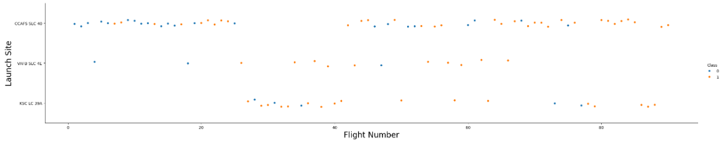
Flight Number vs. Launch Site
As the number of flights increase, the success rate (class = 1) tend to increase, no matter where the launch took place. However, we can see that, overall, the launch site KSC LC 39A has the best success ration among them.

Slide 19
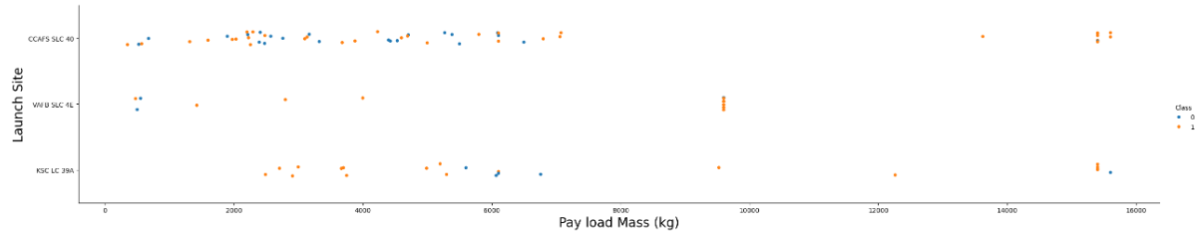
Payload vs. Launch Site
We can see in this graph that for the VAFB SLC 4E Launch Site there were no rockets launched for a Payload mass greater than 10,000 Kg.

Slide 20
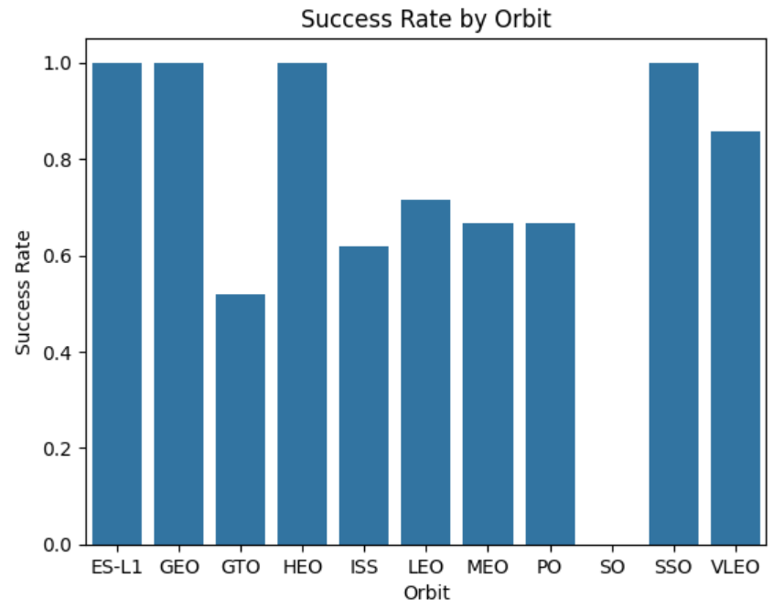
Success Rate vs. Orbit Type
EL-L1, GEO, HEO, and SSO are the orbits with 100% of landing success rate.

Slide 21
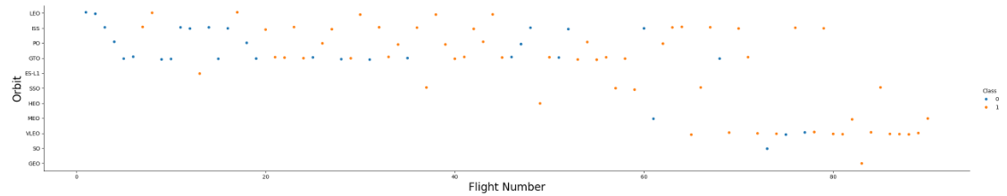
Flight Number vs. Orbit Type
In the LEO orbit, the success appears related to the number of flights.
However, in the GTO orbit, there is no relationship between the success rate and the number of flights.

Slide 22
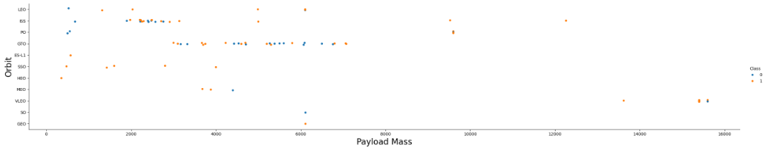
Payload vs. Orbit Type
We can see that for LEO and ISS orbits there is successful landing rate for the heavier payloads.

Slide 23
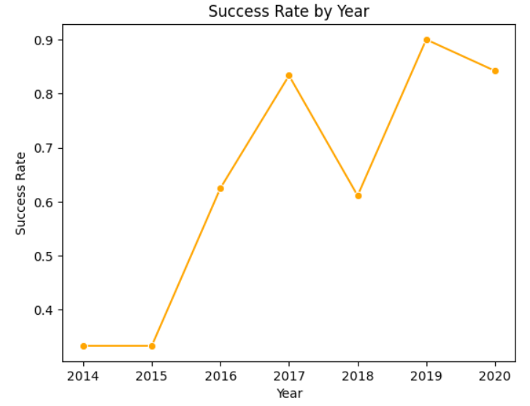
Launch Success Yearly Trend
The success rate is increasing from 2014 until 2020 – upward trend.

Slide 24
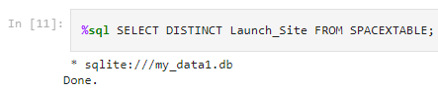
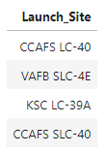
All Launch Site Names
The SELECT DISTINCT statement was used to filter all launch site names from the SpaceX data.

Slide 25
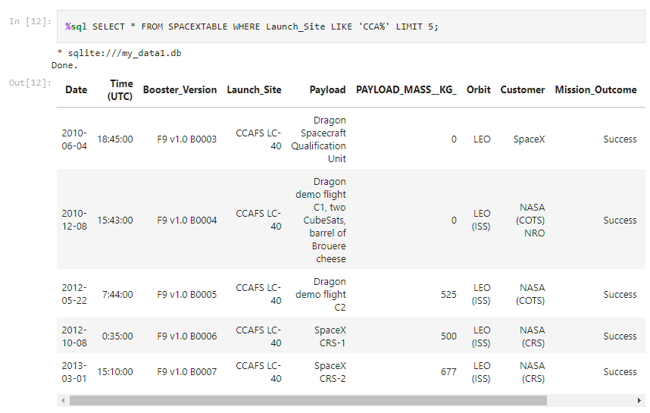
Launch Site Names Begin with 'CCA'
The LIKE operator was used to filter the launch sites beginning with ‘CCA’ and the operator LIMIT was used to show just 5 entries of the result.

Slide 26
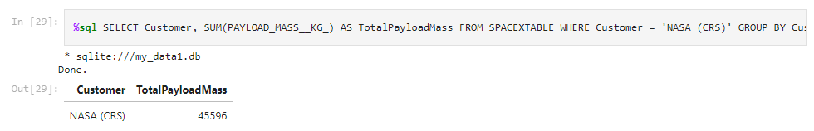
Total Payload Mass
The total payload mass carried by boosters from NASA was 45596, using the query below (with the statements WHERE and GROUP BY, and with the function SUM):

Slide 27
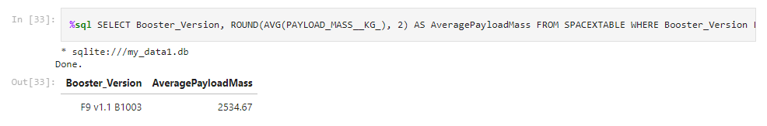
Average Payload Mass by F9 v1.1
The average payload mass carried by booster version F9 v1.1 is 2,534.67, as shown in the query below (using ROUND, WHERE, and LIKE):

Slide 28
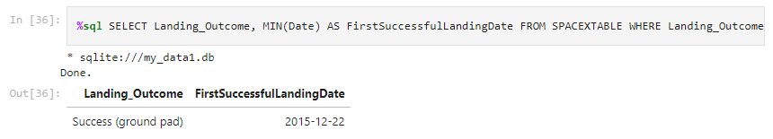
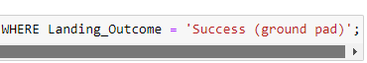
First Successful Ground Landing Date
December 12th 2015 was the date of the first successful landing outcome on ground pad was achieved, as observed in the result below:

Slide 29
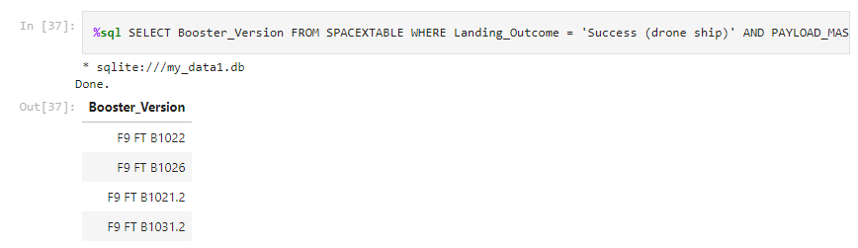
Successful Drone Ship Landing with Payload between 4000 and 6000
Below we can observe the list the names of boosters which have successfully landed on drone ship and had payload mass greater than 4000 but less than 6000. The query used had the WHERE clause and AND condition to determine the result.
%sql SELECT Booster_Version FROM SPACEXTABLE WHERE Landing_Outcome = 'Success (drone ship)' AND PAYLOAD_MASS__KG_ > 4000 AND PAYLOAD_MASS__KG_ < 6000;

Slide 30
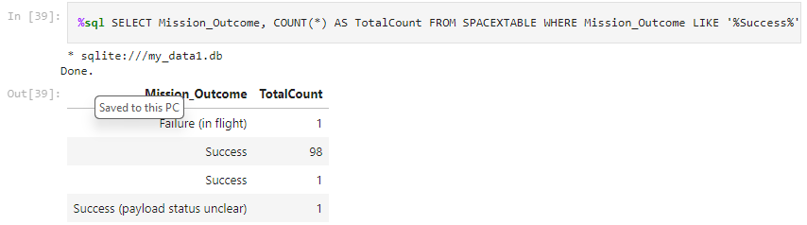
Total Number of Successful and Failure Mission Outcomes
The total number of successful (total = 100) and failure (total = 1) missions outcome can be observed below. For this task the COUNT function, WHERE clause, LIKE and OR operators, and GROUP BY statement, were used.
%sql SELECT Mission_Outcome, COUNT(*) AS TotalCount FROM SPACEXTABLE WHERE Mission_Outcome LIKE '%Success%' OR Mission_Outcome LIKE '%Failure%' GROUP BY Mission_Outcome;

Slide 31
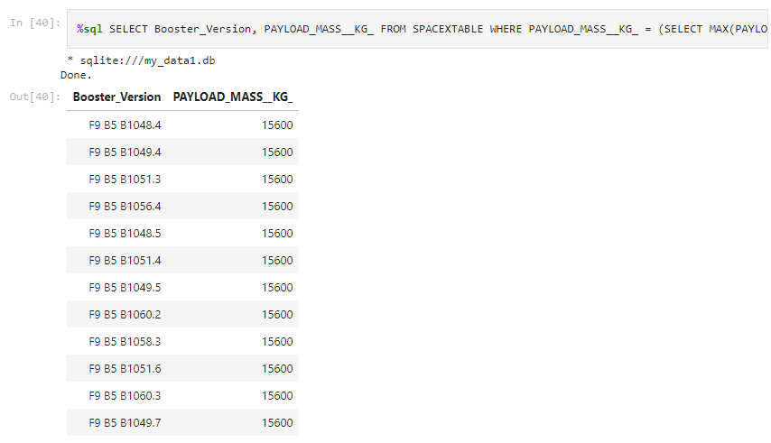
Boosters Carried Maximum Payload
Below we can observe the names of the booster which have carried the maximum payload mass, using a subquery in the WHERE clause:
%sql SELECT Booster_Version, PAYLOAD_MASS__KG_ FROM SPACEXTABLE WHERE PAYLOAD_MASS__KG_ = (SELECT MAX(PAYLOAD_MASS__KG_) FROM SPACEXTABLE);

Slide 32
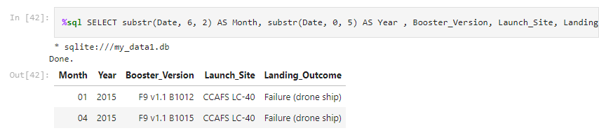
2015 Launch Records
Combining the usage of the WHERE and AND condition, we can observe the list of failed landing_outcomes in drone ship, their booster versions, and launch site names for in year 2015:
%sql SELECT substr(Date, 6, 2) AS Month, substr(Date, 0, 5) AS Year , Booster_Version, Launch_Site, Landing_Outcome FROM SPACEXTABLE WHERE substr(Date, 0, 5) = '2015' AND Landing_Outcome = 'Failure (drone ship)';

Slide 33
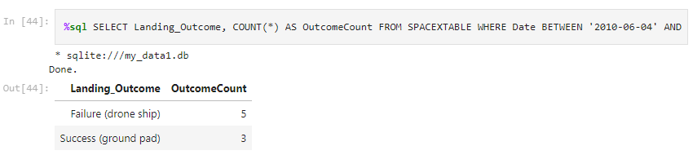
Rank Landing Outcomes Between 2010-06-04 and 2017-03-20
Below is the ranking of landing outcomes (such as Failure (drone ship) or Success (ground pad)) between the date 2010-06-04 and 2017-03-20, in descending order, using the WHERE clause, BETWEEN, GROUP BY, and ORDER BY conditions:
%sql SELECT Landing_Outcome, COUNT(*) AS OutcomeCount FROM SPACEXTABLE WHERE Date BETWEEN '2010-06-04' AND '2017-03-20' AND Landing_Outcome IN ('Failure (drone ship)', 'Success (ground pad)') GROUP BY Landing_Outcome ORDER BY OutcomeCount DESC;

Slide 34

Section 3

Slide 35
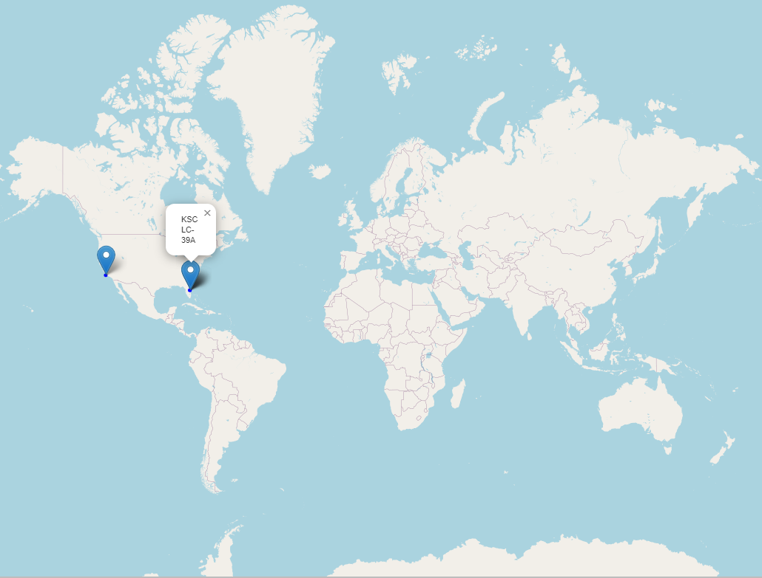
SpaceX’s launch sites
From this map we can observe that all SpaceX’s launch sites are inside of the US territory.
This is shown by the blue markers on the map, and if you click in each market it will show the name of the launch site.

Slide 36
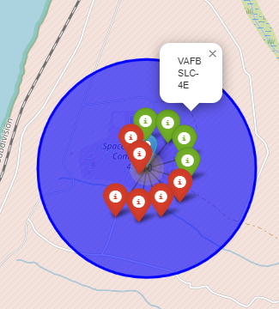
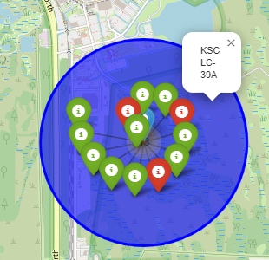
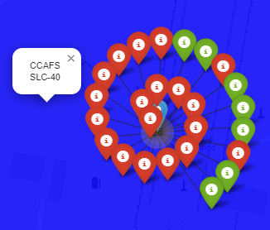
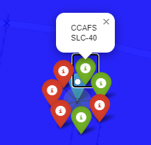
Success/failed launches for each site
Below we can see all of the launch sites, one in California and three in Florida. In each of them, there are markers for successful launches (green) and for failures (red)
California
Florida

Slide 37
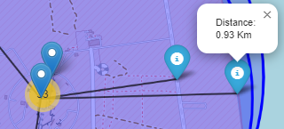
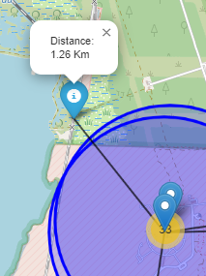
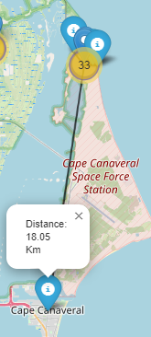
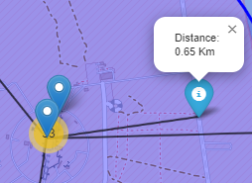
Launch site and its proximities
Below we can observe the distances to key points from one of the launch sites:
Distance to the coastline:
Distance to railway:
Distance to the nearest city:
Distance to the highway:

Slide 38

Section 4

Slide 39
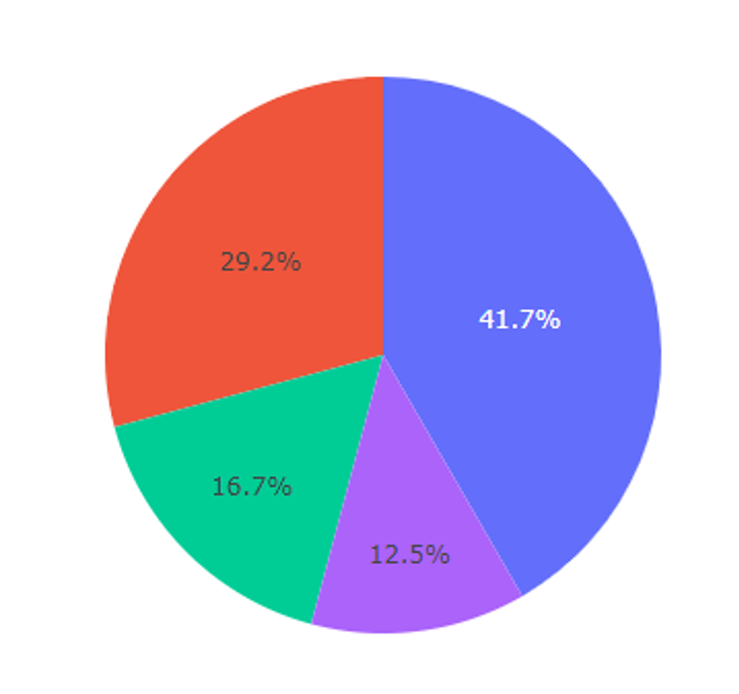
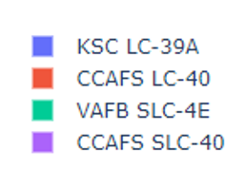
Total success launches by site
We can observe in the pie chart below that KSC LC-39A is the place that had the most significant successful launches among the launch sites.

Slide 40
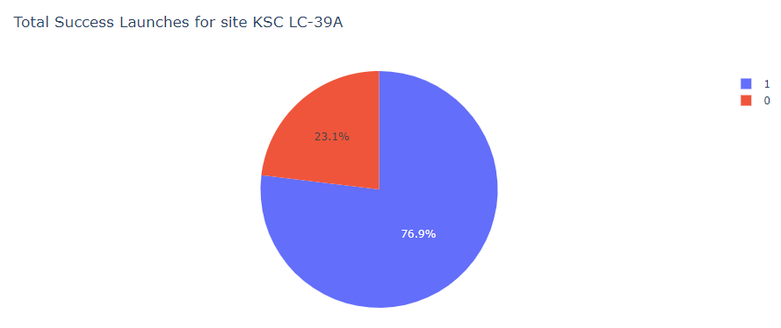
Total launches for site KSC LC-39A
We can see in the graph below that 76.9% of the launches performed in site KSC LC-39A were successful and 23.1% failed.

Slide 41
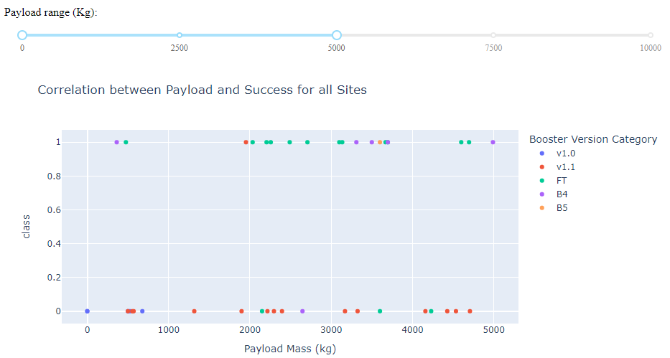
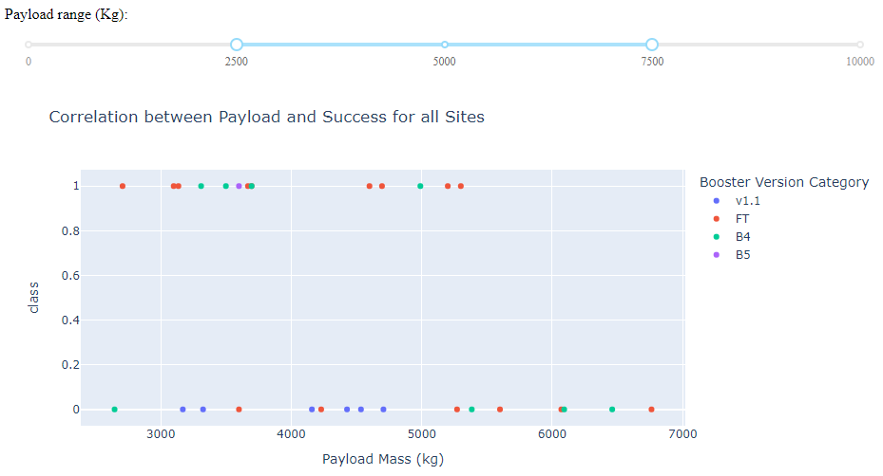
Scatter plot of Payload vs. Launch outcomes for all sites, with different payload selected in the range slider
We can see that in both cases of payload (low and mid range) the Booster version FT is the most successful.
Payload: 0kg – 5000kg
Payload: 2500kg – 7500kg

Slide 42

Section 5

Slide 43
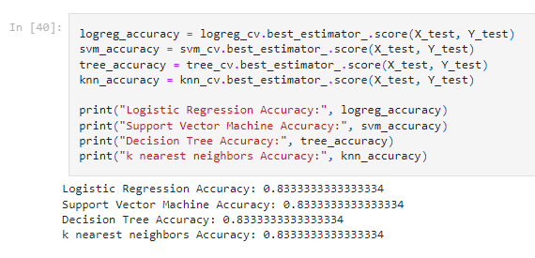
Classification Accuracy
Below, the accuracy of the classification models can by visualized:
From the results, we can conclude that all the models have the same accuracy: 83.34%.

Slide 44
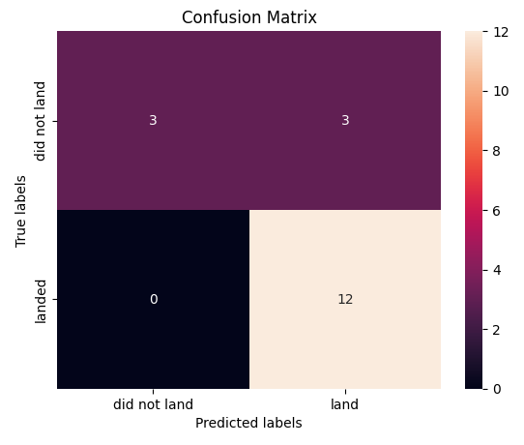
Confusion Matrix
The confusion matrix for the decision tree classifier shows that the model can predict successfully the landed cases, but it has issues in the false positive case (when the classifier marks as successful landing and it was unsuccessful).

Slide 45
Conclusions
ES-L1, GEO, HEO, and SSO are the orbits with the best success rates.
Success rate by Year is in upward trend, because of the increased number of launches SpaceX performs each year.
KSC LC-39A is the launch site with the most successful number of launches.
Booster version FT has the most successful launch outcomes
After fine tuning all the machine learning models, they all had the same accuracy: 83.3%
Better and more precise results we can get if more data is available, which will happen in the future. This is the key element about data science.

Slide 46
Appendix
Libraries used in this project:
Pandas
Numpy
BeautifulSoup
Sqlite3
Matplotlib
Seaborn
Folium
Dash
Plotly
Sklearn

Slide 47


